Slide 1
"When developing our test strategy, we must minimize the impact caused by changes in the applications we are testing, and changes in the tools we use to test them."
--Carl J. Nagle

Slide 2
Test Harness / ATF
Purpose of Automation
Making Automation Successful
All About Test Harness/ATF
Components of ATF
Different Types of ATF
Integrating ATF with Other Tools
ATF Workflow

Slide 3
Purpose of Automation
Why do we need Automation
  For a reduction in project cycle times
  To reduce the risks associated with manual testing
Why Test Automation Fails
  Automation tool vendors do not provide completely forthright demonstrations when showcasing the "simplicity" of their tools
  Fully capable testers are seldom given the time required to gain the appropriate software development skills. For the most part, testers have been testers, not programmers
  Test automation must be approached as a full-blown software development effort in its own right. Without this, it is most likely destined to failure in the long term.
  Commercial automation tools have been chiefly marketed for use as solutions for testing an application instead be sought as the cornerstone for an enterprise-wide test automation framework

Slide 4
How to Make Test Automation Successful
  In order to make the most of our test strategy, we need to make it reusable and manageable. To that end, there are some essential guiding principles we should follow when developing our overall test strategy:
  Test automation is a fulltime effort, not a sideline.
  The test design and the test framework are totally separate entities.
  The test framework should be application-independent.
  The test framework must be easy to expand, maintain, and perpetuate.
  The test strategy/design vocabulary should be framework independent.
  The test strategy/design should remove most testers from the complexities of the test framework.

Slide 5
What is Test Harness
A test harness is a testing work product modeling a software tool that automates the testing process by running test suites of test cases.
The typical objectives of a test harness is to:
  Automate the testing process.
  Execute test suites of test cases.
  Generate associated test reports.
A test harness typically provides the following benefits:
  Increased productivity due to automation of the testing process.
  Increased probability that regression testing will occur.
  Increased quality of software components and application.

Slide 6
Components of Test Harness
Core Engine
Component Functions
Support Libraries
Test documentation database
Test results database
Report builder
Integration with other tools such as defect tracking and configuration management tools.

Slide 7
Types of Test Harness
Data Driven Automation Frameworks
Keyword or Table Driven Test Automation
Hybrid Test Automation

Slide 8
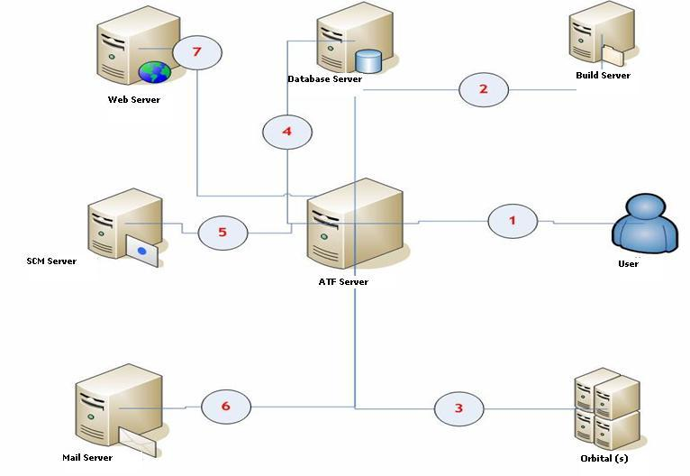
Test Harness Components Diagram

Slide 9
Test Harness Workflow
Download and Deploy the latest build
Configure the Orbitals
Install licenses
Set bandwidth limitations
Configure the Delay Router
Set any other required software/tools
Download the latest scripts from the SCM server
Execute the scripts (individual/suite) and record the logs and results
Store the results and logs on File Server and send the reports via mail server
Clean up the environment
Post the bugs (Product Defect Bugs/Script Defect Bugs)
Generate the required results

Slide 10
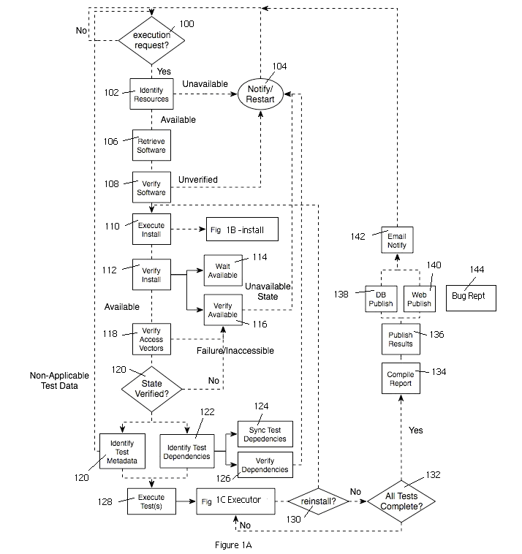
Test Harness Workflow Diagram

Slide 11
Features of Orbital Test Harness
Can execute the scripts on the latest build or specified build
Can execute the same set of scripts n number of times on the pre-installed build
Can execute a single script, n number of scripts or complete suite
Can deploy and setup the environment for each script
Recording of logs can be set at different levels
Sending of reports can be enabled/disabled
Posting of bugs for the failed tests can be enabled/disabled
Web interface/console interface for initiating the execution and analyzing the reports

Slide 12
Thank You

